Slide 1
Message Queues

Slide 2
Message Queues
A message queue is a software component used for passing data (messages) between services.
It exposes an interface for adding, reading, and removing messages.
Generally speaking, messages are persisted.
Examples
RabbitMQ, Amazon SQS, and Apache Kafka.

Slide 3
Message Queues
Message queues facilitate asynchronous communication between discrete services.
There can be multiple producers (services adding messages to the queue) and consumers (services taking messages from the queue).
The producers and consumers are decoupled in time and space; a producer need not know when or by whom a message will be consumed.

Slide 4
Message Queues - Benefits
Resiliency - A consumer can go down temporarily and begin processing messages when it comes back online, without affecting other services.
Scalability - To increase the rate at which messages are added or processed, simply add more producers or consumers.
Visibility - Examining the queue itself can provide valuable insight into the health of an application.

Slide 5
Messaging Models

Slide 6
Point-to-Point Messaging Model
In the Point-to-Point messaging model, the producer is called as a sender and the consumer is called as a receiver.
Senders and Receivers are exchange messages through a virtual channel called a queue. A queue is a destination to which producers send messages and a source from which receivers consume messages.
Each message is delivered to only one receiver. Multiple receivers may listen on a queue, but each message in the queue may only be consumed by one of the queue’s receivers.
Messages are ordered. A queue delivers messages to destined receiver in the order they were placed in the queue by the message server. As messages are consumed, they are removed from the head of the queue (unless message priority is used).

Slide 7
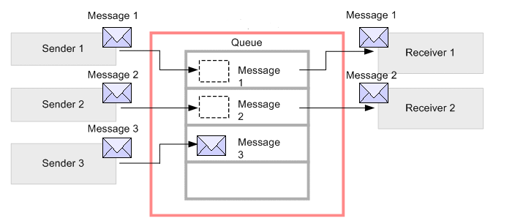
Point-to-Point Messaging Model
The sender sends the messages and those messages are registered in the queue. The messages registered in the queue are delivered to destined receivers running at that time (message1 and message2).
Then, the delivered messages are deleted/removed from the queue. If the destined receiver doesn't exist, the messages are accumulated in the queue (message3).

Slide 8
Pub/Sub Messaging Model
The pub/sub messaging model allows a message producer (also called a publisher) to broadcast a message to one or more consumers (called subscribers).
Publisher and Subscribers exchange means through an intermediary channel called as topic.
Publishers produce messages to a topic and Subscribers subscribe to a topic and consume messages from a topic.
Publishers doesn't have the knowledge about the subscribers.

Slide 9
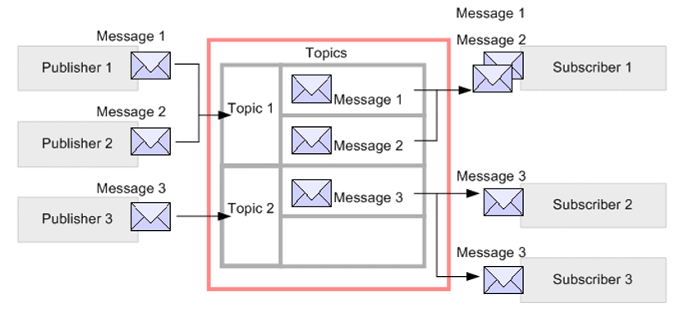
Pub/Sub Messaging Model
A publisher creates and sends messages to a topic. Subscribers subscribe to a topic, to receive messages from it.
Communication can be one-to-many, many-to-one, and many-to-many.

Slide 10
Apache Kafka

Slide 11
Apache Kafka
We use Apache Kafka to enable communication between producers and consumers using message-based topics.
Apache Kafka is a distributed streaming platform, used to
Publish and subscribe to streams of records, similar to a message queue or enterprise messaging system.
Store streams of records in a fault-tolerant durable way.
Process streams of records as they occur.

Slide 12
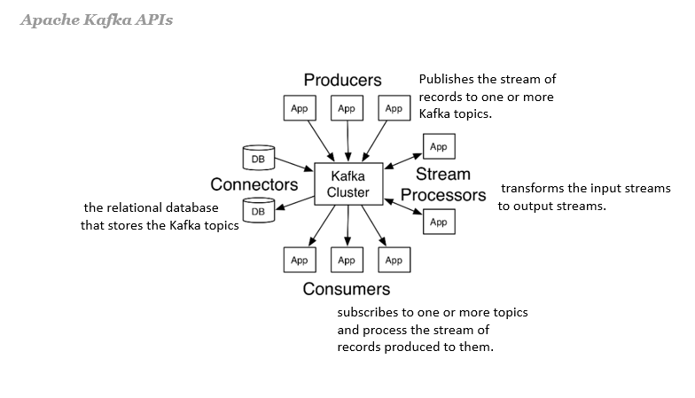
Apache Kafka
Kafka run as a cluster on one or more servers that can span multiple datacenters.
The Kafka cluster stores streams of records in categories called topics.
Each record consists of a key, a value, and a timestamp.

Slide 13
Apache Kafka
Kafka Broker - A Kafka broker (server) handles all requests from clients (produce, consume, and metadata) and persists and replicates the data within the cluster. There can be one or more brokers in a cluster. For the purpose of managing and coordinating, Kafka broker uses ZooKeeper. Also, uses it to notify producer and consumer about the presence of any new broker in the Kafka system or failure of the broker in the Kafka system.
Kafka Topic - A Topic is a category/feed name to which records are stored and published.
A Kafka Producer pushes the message into the Kafka Topic.
A Kafka Consumer pulls the message from the Kafka Topic.
Partitions in Kafka - Kafka topics are divided into a number of partitions, which contain immutable sequence of records records. Each record in a partition is assigned and identified by its unique offset.

Slide 14
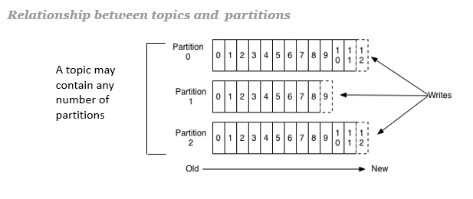
Apache Kafka
A topic can also have multiple partition logs distributed over the servers in the Kafka cluster with each server handling data and requests for a share of the partitions. This allows multiple consumers to read from a topic in parallel.
In Kafka, replication is implemented at the partition level. Each partition is replicated across a configurable number of servers for fault tolerance.

Slide 15
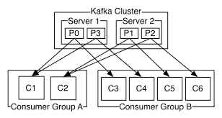
Apache Kafka
Consumer group - Consumers label themselves with a consumer group name, and each record published to a topic is delivered to one consumer instance within each subscribing consumer group. Consumer instances can be in separate processes or on separate machines

Slide 16
Apache Kafka as a Messaging System
In Kafka, these two messaging models are generalized by the Kafka consumer group.
As with a queue the consumer group allows us to divide up processing over a collection of processes (the members of the consumer group).
As with publish-subscribe, Kafka allows us to broadcast messages to multiple consumer groups.
The advantage of Kafka's model is that every topic has both these properties: — it can scale processing and is also multi-subscriber — there is no need to choose one or the other.

Slide 17
Spring for Apache Kafka
The Spring for Apache Kafka project applies core Spring concepts to the development of Kafka-based messaging solutions.
It provides a "template" as a high-level abstraction for sending messages.
It also provides support for Message-driven POJOs with @KafkaListener annotations and a "listener container".
KafkaTemplate - A template for executing high-level operations.
KafkaMessageListenerContainer - used to construct an instance with the supplied configuration properties.
@KafkaListener - Annotation that marks a method to be the target of a Kafka message listener on the specified topics.

Slide 18
ZooKeeper
Like Kafka, ZooKeeper is also an open source tool provided by the Apache Software Foundation.
It provides a centralized service in distributed systems such as providing configuration information, synchronization, naming registry, and other group services over large clusters. Kafka uses Zookeeper in order to track the status of nodes in the Kafka cluster.

Slide 19
Role of Zookeeper in Kafka
While working with any distributed system, there should be a way to coordinate tasks.
In our context, Kafka is a distributed system that uses ZooKeeper to co-ordinate its tasks.

Slide 20
Role of Zookeeper in Kafka
When working with Apache Kafka, the primary role of ZooKeeper is to track the status of nodes in the Kafka cluster and also maintain a list of Kafka topics and messages.
ZooKeeper coordinates the brokers/cluster topology.
ZooKeeper acts as a consistent file system for configuration information. Moreover, it contains a list of all Kafka brokers with it. It notifies Kafka, if any broker goes down, or partition goes down or new broker is up or partition is up.
ZooKeeper also accesses how much data each client is allowed to read/write.
In addition, Kafka uses Zookeeper to store offsets of messages consumed for a specific topic and partition by a specific Consumer Group.

